Slide 1

CHICAGO CAR CRASH PROJECT - ML

Slide 2
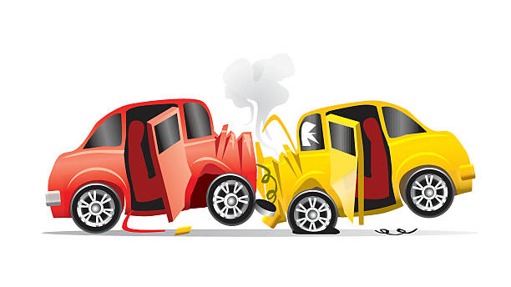
Agenda
INTRODUCTION
SUMMARY
OUTLINE
BUSINESS PROBLEM
DATA
TECHNIQUES
RESULTS AND FINDIGS
RECOMMENDATION
MODELLING
REMARKS

Slide 3
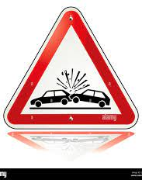
PROBLEM STATEMENT
- The primary objective of this study is to identify and understand the main contributing factors to car accidents in Chicago, with a specific focus on driver behavior.
- By analyzing various modeling techniques and their results, the aim is to determine the primary causes of car accidents and provide insights that can contribute to the development of effective strategies for accident prevention and road safety improvement.

Slide 4

DATA
Data in this case is obtained from https://data.cityofchicago.org/Transportation/Traffic-Crashes-Crashes/85ca-t3if

Slide 5
TECHNQUES
Data Collection
Data Preprocessing:
Exploratory Data Analysis
Feature Selection
Modeling Techniques:
Regression Analysis:
Classification Analysis:
Clustering Analysis
Model Evaluation
Interpretation and Recommendations

Slide 6

RESULTS
INTRODUCTION
SUMMARY
OUTLINE
BUSINESS PROBLEM
DATA
TECHNIQUES
RESULTS AND FINDIGS
RECOMMENDATION
MODELLING
REMARKS

Slide 7
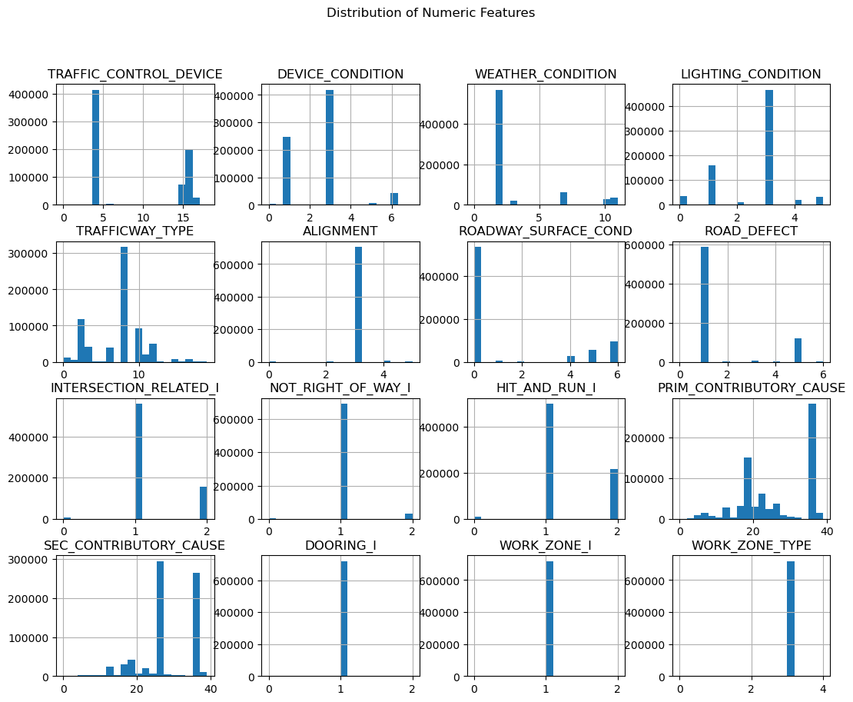
VISUALISATIONS
Some of the visualizations done

Slide 8
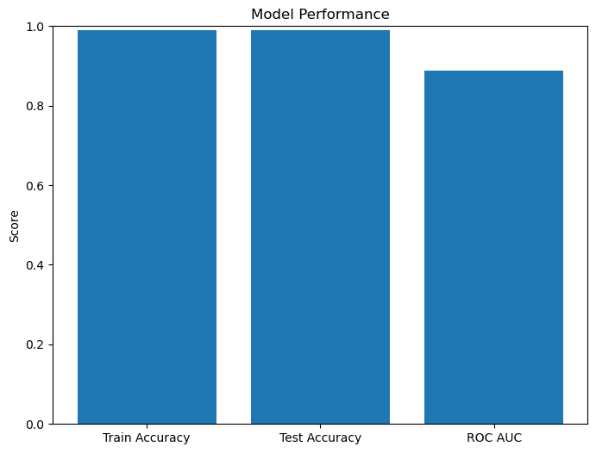
MODELLING: RandomClassifer
RandomClassifer has been used to train and test
Train Accuracy: 0.9907520128378939
Test Accuracy : 0.9907520128378939 ROC Curve: 0.8871933925078359
RandomClassifier Model Bar Graph

Slide 9
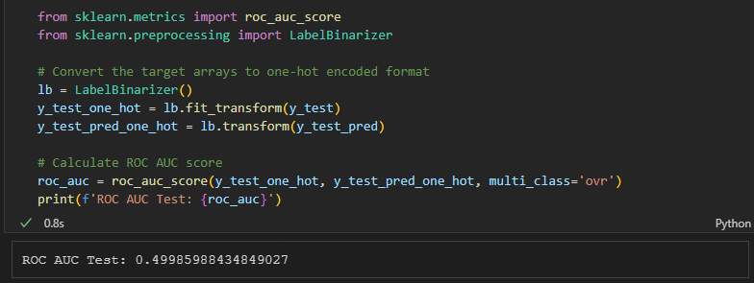
MODELLING:KNN XGBOOST
Produces the poorest model results

Slide 10
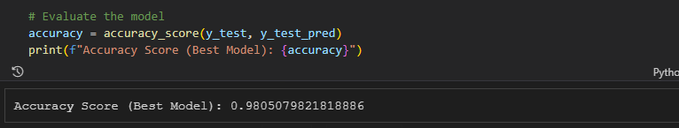
MODELLING: KNN:GridSearch
- The accuracy score represents the proportion of correctly classified instances out of the total number of instances in the test set. In this case, the best KNN model achieved an accuracy score of approximately 0.9805, which means that it correctly predicted the class labels for approximately 98.05% of the instances in the test data.

Slide 11
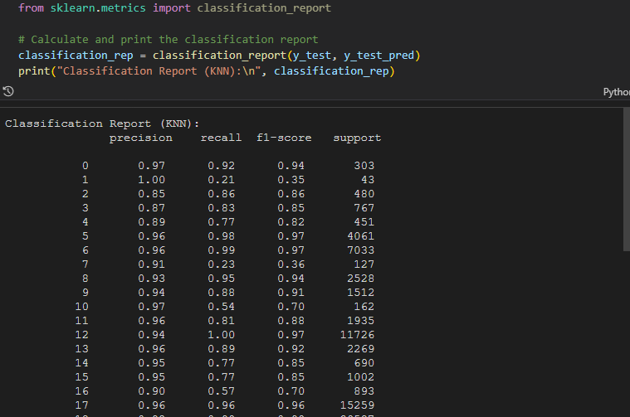
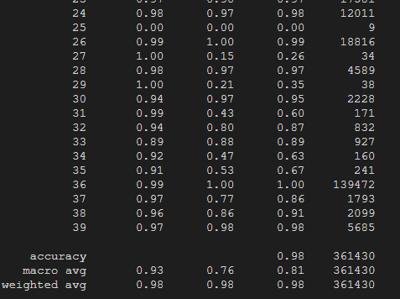
Classification report

Slide 12
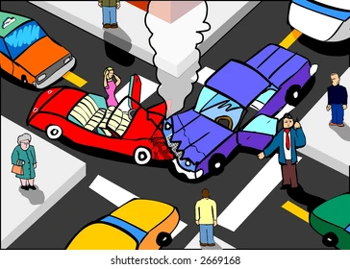
Conclusion
Based on the different models conducted and the analysis of their results, one of the primary causes for car accidents in Chicago could be identified as the "Driver's Behavior."- Several factors related to driver behavior, such as speeding, reckless driving, distracted driving, and impaired driving, consistently appeared as significant features in the models and had a strong impact on crash outcomes.
These findings suggest that driver-related factors play a crucial role in contributing to car accidents in Chicago..

Slide 13

RECOMMENDATION
- By analyzing the models' feature importance and coefficients, it can be inferred that addressing driver behavior through targeted interventions, awareness campaigns, and stricter enforcement of traffic regulations could potentially help mitigate the occurrence of car accidents in Chicago.
- However, it's important to note that the primary cause of accidents can vary based on various factors such as the dataset used, the modeling techniques employed, and the specific context of the analysis.
- It is recommended to consider a comprehensive approach that takes into account multiple factors, including road infrastructure, weather conditions, and other external influences, to gain a holistic understanding of the primary causes of car accidents in Chicago.

